Slide 1
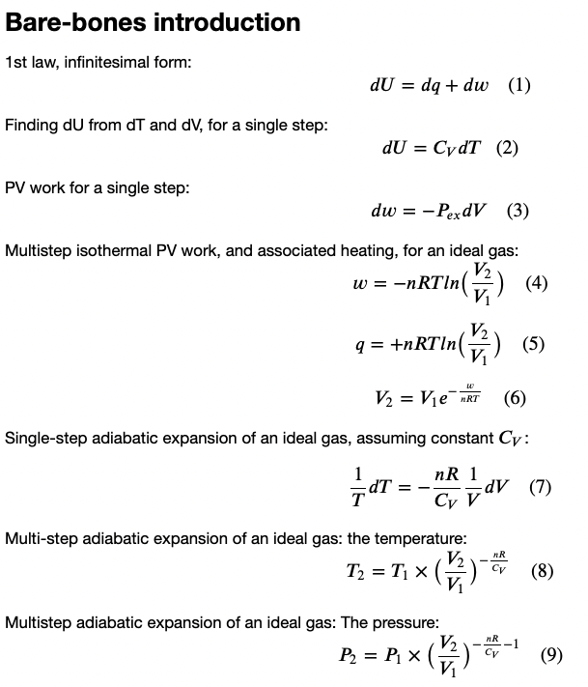
Last time …
Heat, work, and the 1st Law
Explore how that relates to the behavior of gases as they expand & contract

Slide 2
Today …
Heat, work, and the 1st Law
Explore how that relates to the behavior of gases as they expand & contract

Slide 3

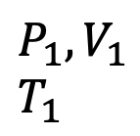







Single-step adiabatic expansion of an ideal gas
Some interpretation …
$$\frac{1}{T}dT=−\frac{nR}{C_{V}} \frac{1}{V}dV$$
$\frac{1}{V}dV$ is the fractional change in volume. Multiply that by $−\frac{nR}{C_{V}}$ to get the fractional change in temperature! Works with % too.
$$U(T,V)$$
V
$$P_{ex}$$
T
$$P_{ex}$$
$$P_{2},V_{2}$$
$$T_{2}$$
$$P_{1},V_{1}$$
$$T_{1}$$
$$P_{ex}$$
No heat going in/out
Temperature is going down
$$dV$$
$$V$$

Slide 4

Single-step adiabatic expansion of an ideal gas
Example:
Say V increases from 10 -> 11 L
$\frac{1}{V}dV=0.1$ (or $10\%$)
If an ideal diatomic gas,
$\frac{nR}{C_{V}}=\frac{R}{\frac{7}{2}R}=\frac{2}{7}$
Then $\frac{1}{T}dT=−\frac{nR}{C_{V}} \frac{1}{V}dV$ says
$$\frac{1}{T}dT=−\frac{2}{7}×10\%=3\%$$
Like 300 K -> 291 K
$$U(T,V)$$
V
$$P_{ex}$$
T
$$P_{ex}$$
$$P_{2},V_{2}$$
$$T_{2}$$
$$P_{1},V_{1}$$
$$T_{1}$$
$$P_{ex}$$
No heat going in/out
Temperature is going down
$$dV$$
$$V$$

Slide 5


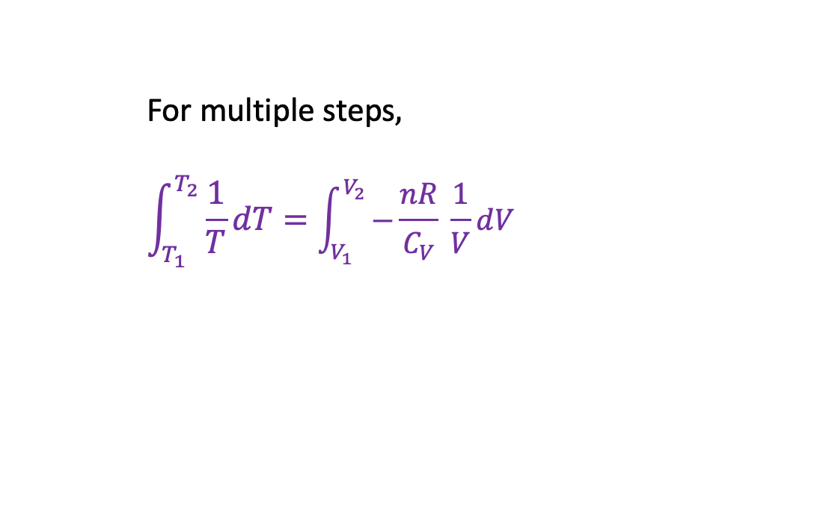


Multi-step adiabatic expansion of an ideal gas
For multiple steps,
$$\int_{T_{1}}^{T_{2}}{\frac{1}{T}dT}=\int_{V_{1}}^{V_{2}}{−\frac{nR}{C_{V}} \frac{1}{V}}dV$$
$$U(T,V)$$
V
$$P_{ex}$$
T
$$P_{ex}$$
$$P_{2},V_{2}$$
$$T_{2}$$
$$P_{1},V_{1}$$
$$T_{1}$$
$$P_{ex}$$
No heat going in/out
Temperature is going down
$$P_{Ideal}=nRT/V$$
$$V_{1}$$
$$V_{2}$$

Slide 6
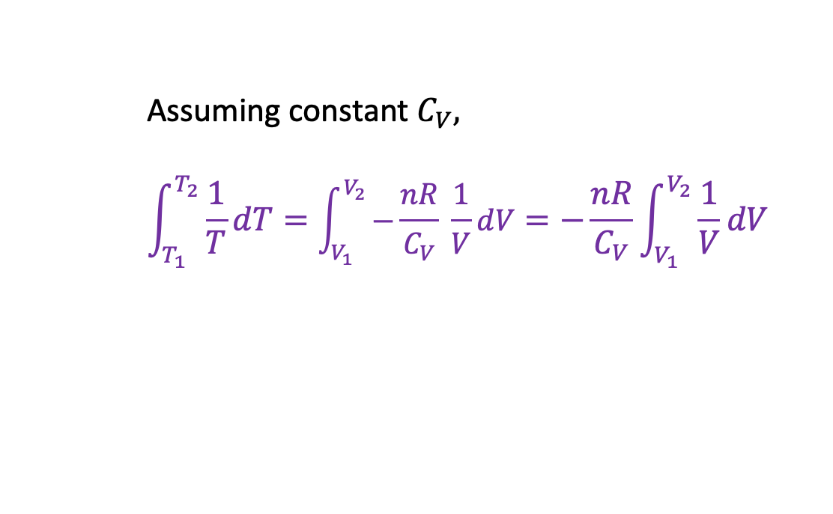
Multi-step adiabatic expansion of an ideal gas
Assuming constant $C_{V}$,
$$\int_{T_{1}}^{T_{2}}{\frac{1}{T}dT}=\int_{V_{1}}^{V_{2}}{−\frac{nR}{C_{V}} \frac{1}{V}}dV=−\frac{nR}{C_{V}}\int_{V_{1}}^{V_{2}}{\frac{1}{V}dV}$$
$$U(T,V)$$
V
$$P_{ex}$$
T
$$P_{ex}$$
$$P_{2},V_{2}$$
$$T_{2}$$
$$P_{1},V_{1}$$
$$T_{1}$$
$$P_{ex}$$
No heat going in/out
Temperature is going down
$$P_{Ideal}=nRT/V$$
$$V_{1}$$
$$V_{2}$$

Slide 7
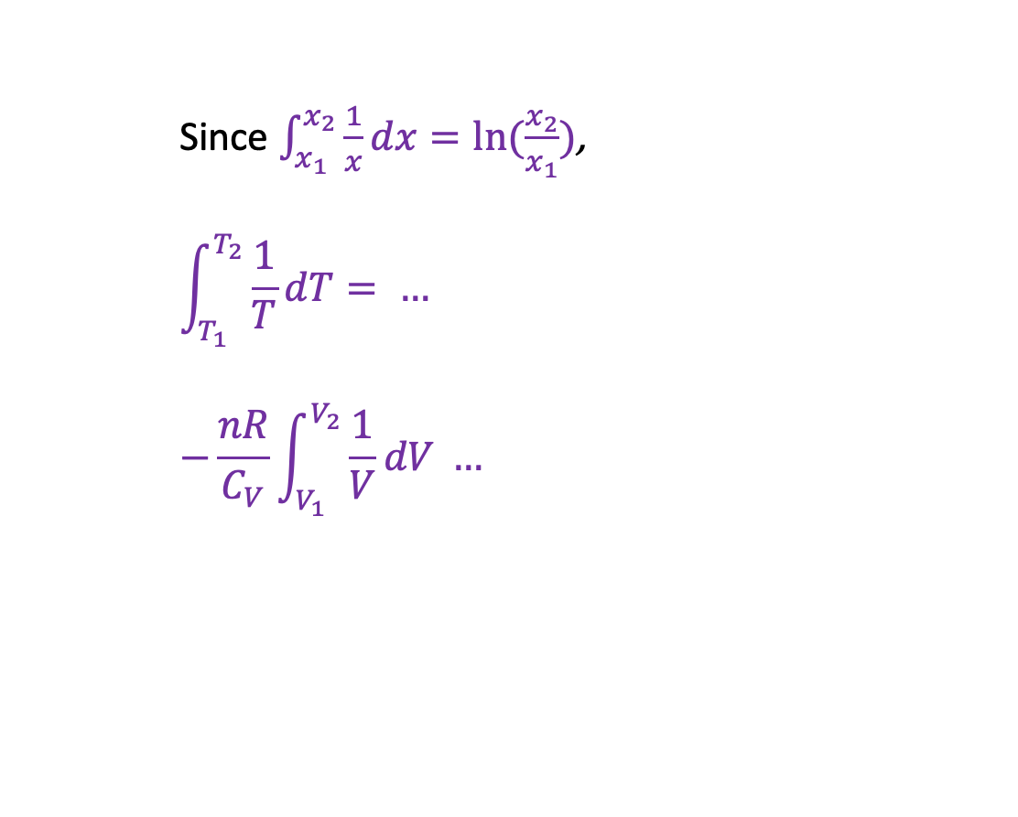
Multi-step adiabatic expansion of an ideal gas
Since $\int_{x_{1}}^{x_{2}}{\frac{1}{x}dx}=ln⁡(\frac{x_{2}}{x_{1}})$,
$$\int_{T_{1}}^{T_{2}}{\frac{1}{T}dT}= …$$
$$−\frac{nR}{C_{V}}\int_{V_{1}}^{V_{2}}{\frac{1}{V}dV} …$$
$$U(T,V)$$
V
$$P_{ex}$$
T
$$P_{ex}$$
$$P_{2},V_{2}$$
$$T_{2}$$
$$P_{1},V_{1}$$
$$T_{1}$$
$$P_{ex}$$
No heat going in/out
Temperature is going down
$$P_{Ideal}=nRT/V$$
$$V_{1}$$
$$V_{2}$$

Slide 8
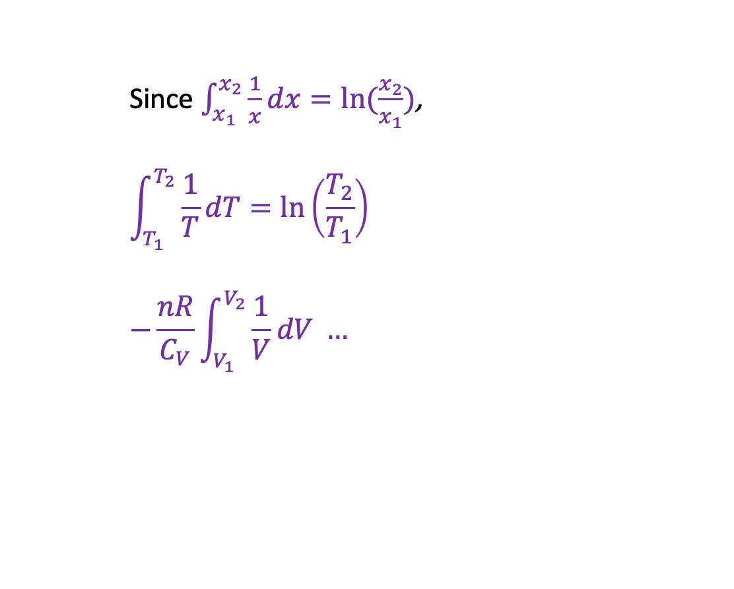
Multi-step adiabatic expansion of an ideal gas
Since $\int_{x_{1}}^{x_{2}}{\frac{1}{x}dx}=ln⁡(\frac{x_{2}}{x_{1}})$,
$$\int_{T_{1}}^{T_{2}}{\frac{1}{T}dT}=\ln\left(\frac{T_{2}}{T_{1}}\right)$$
$$−\frac{nR}{C_{V}}\int_{V_{1}}^{V_{2}}{\frac{1}{V}dV} …$$
$$U(T,V)$$
V
$$P_{ex}$$
T
$$P_{ex}$$
$$P_{2},V_{2}$$
$$T_{2}$$
$$P_{1},V_{1}$$
$$T_{1}$$
$$P_{ex}$$
No heat going in/out
Temperature is going down
$$P_{Ideal}=nRT/V$$
$$V_{1}$$
$$V_{2}$$

Slide 9
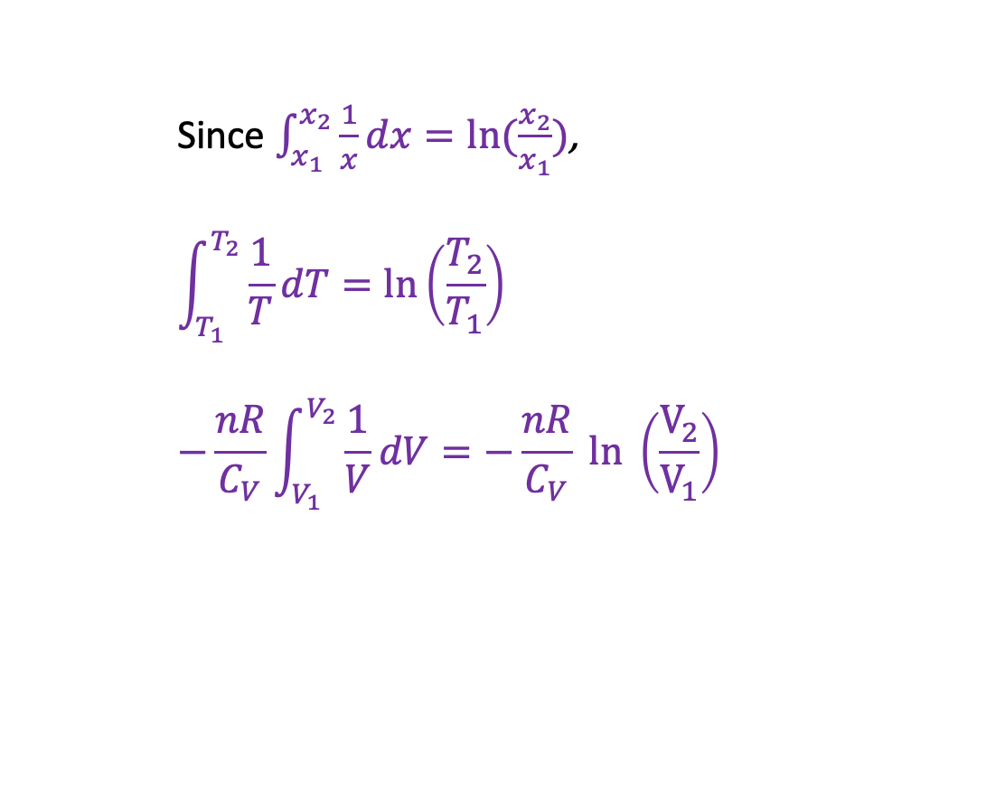
Multi-step adiabatic expansion of an ideal gas
Since $\int_{x_{1}}^{x_{2}}{\frac{1}{x}dx}=ln⁡(\frac{x_{2}}{x_{1}})$,
$$\int_{T_{1}}^{T_{2}}{\frac{1}{T}dT}=\ln\left(\frac{T_{2}}{T_{1}}\right)$$
$$−\frac{nR}{C_{V}}\int_{V_{1}}^{V_{2}}{\frac{1}{V}dV}=−\frac{nR}{C_{V}} ln \left(\frac{V_{2}}{V_{1}}\right)$$
$$U(T,V)$$
V
$$P_{ex}$$
T
$$P_{ex}$$
$$P_{2},V_{2}$$
$$T_{2}$$
$$P_{1},V_{1}$$
$$T_{1}$$
$$P_{ex}$$
No heat going in/out
Temperature is going down
$$P_{Ideal}=nRT/V$$
$$V_{1}$$
$$V_{2}$$

Slide 10
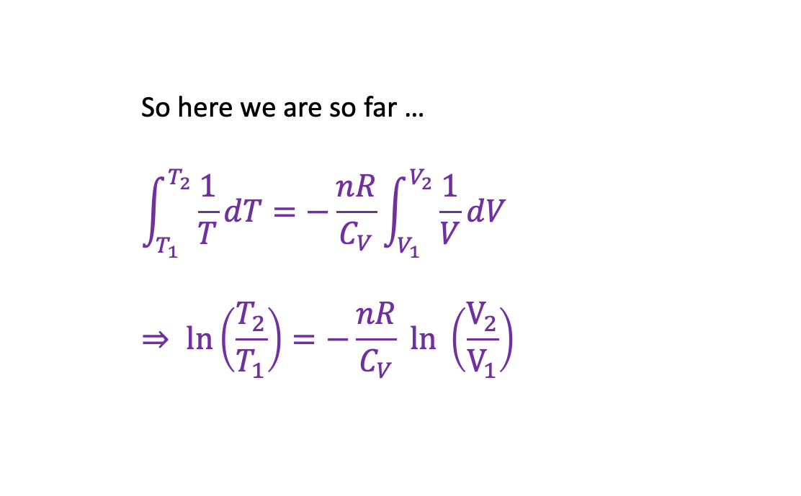
Multi-step adiabatic expansion of an ideal gas
So here we are so far …
$$\int_{T_{1}}^{T_{2}}{\frac{1}{T}dT}=−\frac{nR}{C_{V}}\int_{V_{1}}^{V_{2}}{\frac{1}{V}dV}$$
$$⇒ \ln\left(\frac{T_{2}}{T_{1}}\right)=−\frac{nR}{C_{V}} ln \left(\frac{V_{2}}{V_{1}}\right)$$
$$U(T,V)$$
V
$$P_{ex}$$
T
$$P_{ex}$$
$$P_{2},V_{2}$$
$$T_{2}$$
$$P_{1},V_{1}$$
$$T_{1}$$
$$P_{ex}$$
No heat going in/out
Temperature is going down
$$P_{Ideal}=nRT/V$$
$$V_{1}$$
$$V_{2}$$

Slide 11

Multi-step adiabatic expansion of an ideal gas
Here’s a fancy logarithm rule …
$$\int_{T_{1}}^{T_{2}}{\frac{1}{T}dT}=−\frac{nR}{C_{V}}\int_{V_{1}}^{V_{2}}{\frac{1}{V}dV}$$
$$⇒ \ln\left(\frac{T_{2}}{T_{1}}\right)=−\frac{nR}{C_{V}} ln \left(\frac{V_{2}}{V_{1}}\right)$$
$$⇒ ln\left(\frac{T_{2}}{T_{1}}\right)= ln {\left(\frac{V_{2}}{V_{1}}\right)}^{−\frac{nR}{C_{V}}}$$
$$U(T,V)$$
V
$$P_{ex}$$
T
$$P_{ex}$$
$$P_{2},V_{2}$$
$$T_{2}$$
$$P_{1},V_{1}$$
$$T_{1}$$
$$P_{ex}$$
No heat going in/out
Temperature is going down
$$P_{Ideal}=nRT/V$$
$$V_{1}$$
$$V_{2}$$

Slide 12

Multi-step adiabatic expansion of an ideal gas
Now we take exp(…) of both sides …
$$\int_{T_{1}}^{T_{2}}{\frac{1}{T}dT}=−\frac{nR}{C_{V}}\int_{V_{1}}^{V_{2}}{\frac{1}{V}dV}$$
$$⇒ \ln\left(\frac{T_{2}}{T_{1}}\right)=−\frac{nR}{C_{V}} ln \left(\frac{V_{2}}{V_{1}}\right)$$
$$⇒ ln\left(\frac{T_{2}}{T_{1}}\right)= ln {\left(\frac{V_{2}}{V_{1}}\right)}^{−\frac{nR}{C_{V}}}$$
=> $\frac{T_{2}}{T_{1}}={\left(\frac{V_{2}}{V_{1}}\right)}^{−\frac{nR}{C_{V}}}$
$$U(T,V)$$
V
$$P_{ex}$$
T
$$P_{ex}$$
$$P_{2},V_{2}$$
$$T_{2}$$
$$P_{1},V_{1}$$
$$T_{1}$$
$$P_{ex}$$
No heat going in/out
Temperature is going down
$$P_{Ideal}=nRT/V$$
$$V_{1}$$
$$V_{2}$$

Slide 13

Multi-step adiabatic expansion of an ideal gas
Isolating $T_{2}$ on the left,
$$\int_{T_{1}}^{T_{2}}{\frac{1}{T}dT}=−\frac{nR}{C_{V}}\int_{V_{1}}^{V_{2}}{\frac{1}{V}dV}$$
$$⇒ \ln\left(\frac{T_{2}}{T_{1}}\right)=−\frac{nR}{C_{V}} ln \left(\frac{V_{2}}{V_{1}}\right)$$
$$⇒ ln\left(\frac{T_{2}}{T_{1}}\right)= ln {\left(\frac{V_{2}}{V_{1}}\right)}^{−\frac{nR}{C_{V}}}$$
$$T_{2}=T_{1}{\left(\frac{V_{2}}{V_{1}}\right)}^{−\frac{nR}{C_{V}}}$$
$$U(T,V)$$
V
$$P_{ex}$$
T
$$P_{ex}$$
$$P_{2},V_{2}$$
$$T_{2}$$
$$P_{1},V_{1}$$
$$T_{1}$$
$$P_{ex}$$
No heat going in/out
Temperature is going down
$$P_{Ideal}=nRT/V$$
$$V_{1}$$
$$V_{2}$$

Slide 14
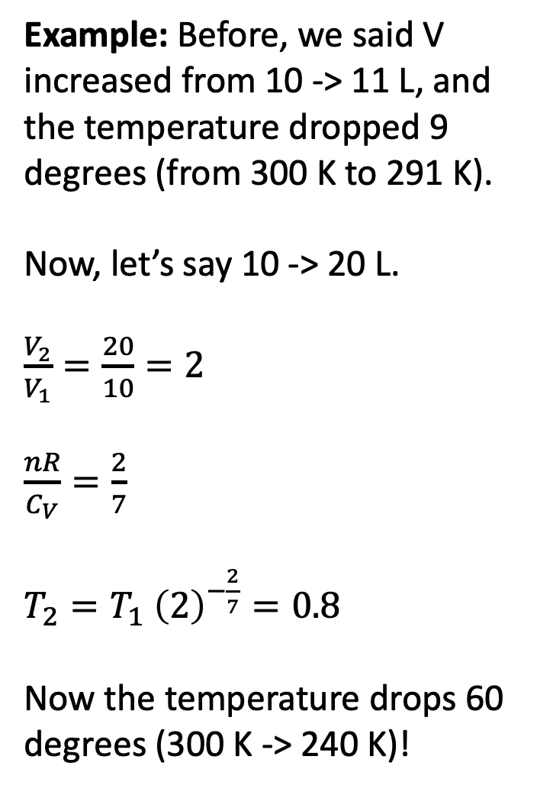
Multistep adiabatic expansion of an ideal gas
Example: Before, we said V increased from 10 -> 11 L, and the temperature dropped 9 degrees (from 300 K to 291 K).
Now, let’s say 10 -> 20 L.
$\frac{V_{2}}{V_{1}}=\frac{20}{10}=2$
$\frac{nR}{C_{V}}=\frac{2}{7}$
$T_{2}=T_{1} {\left(2\right)}^{−\frac{2}{7}}=0.8$
Now the temperature drops 60 degrees (300 K -> 240 K)!
$$U(T,V)$$
V
$$P_{ex}$$
T
$$P_{ex}$$
$$P_{2},V_{2}$$
$$T_{2}$$
$$P_{1},V_{1}$$
$$T_{1}$$
$$P_{ex}$$
No heat going in/out
Temperature is going down
$$P_{Ideal}=nRT/V$$
$$V_{1}$$
$$V_{2}$$

Slide 15

Multistep adiabatic expansion of an ideal gas in terms of pressure
It’s sometimes useful to recast
$\frac{T_{2}}{T_{1}}={\left(\frac{V_{2}}{V_{1}}\right)}^{−\frac{nR}{C_{V}}}$
in terms of pressures. By substituting $\frac{P_{1}V_{1}}{nR}$ for $T_{1}$, and $\frac{P_{2}V_{2}}{nR}$ for $T_{2}$, we can get
$$\frac{P_{2}}{P_{1}}={\left(\frac{V_{2}}{V_{1}}\right)}^{−\frac{nR}{C_{V}}−1}$$
Or, equivalently,
$P_{2}={P_{1}\left(\frac{V_{2}}{V_{1}}\right)}^{−\frac{nR}{C_{V}}−1}$
$$U(T,V)$$
V
$$P_{ex}$$
T
$$P_{ex}$$
$$P_{2},V_{2}$$
$$T_{2}$$
$$P_{1},V_{1}$$
$$T_{1}$$
$$P_{ex}$$
No heat going in/out
Temperature is going down
$$P_{Ideal}=nRT/V$$
$$V_{1}$$
$$V_{2}$$

Slide 16
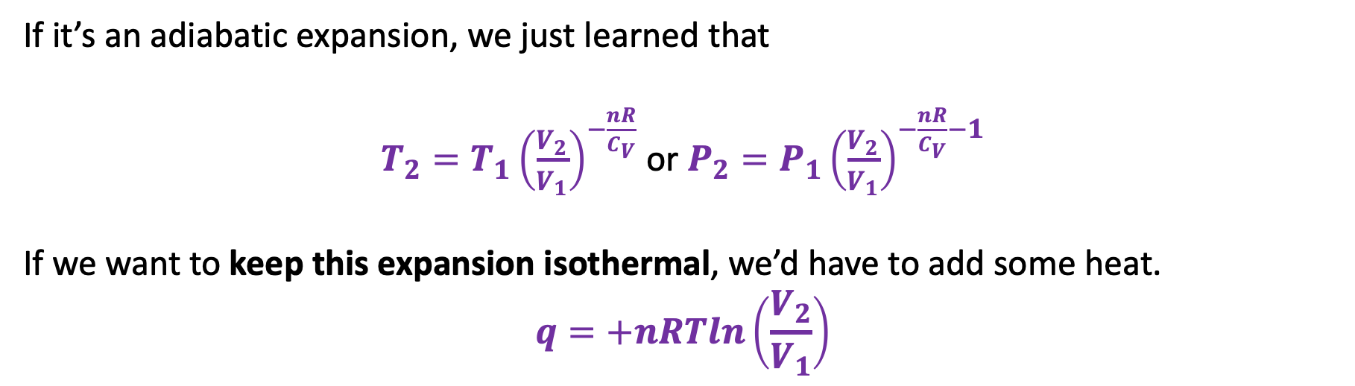
Remember 1st day, on the kinetic-molecular theory of gases?
But when a molecule hits a receding wall, it bounces back more slowly.
Slower-moving molecules correspond to lower temperature.
If it’s an adiabatic expansion, we just learned that
$T_{2}=T_{1}{\left(\frac{V_{2}}{V_{1}}\right)}^{−\frac{nR}{C_{V}}}$ or $P_{2}={P_{1}\left(\frac{V_{2}}{V_{1}}\right)}^{−\frac{nR}{C_{V}}−1}$
If we want to keep this expansion isothermal, we’d have to add some heat.
$$q=+nRTln\left(\frac{V_{2}}{V_{1}}\right)$$

Slide 17
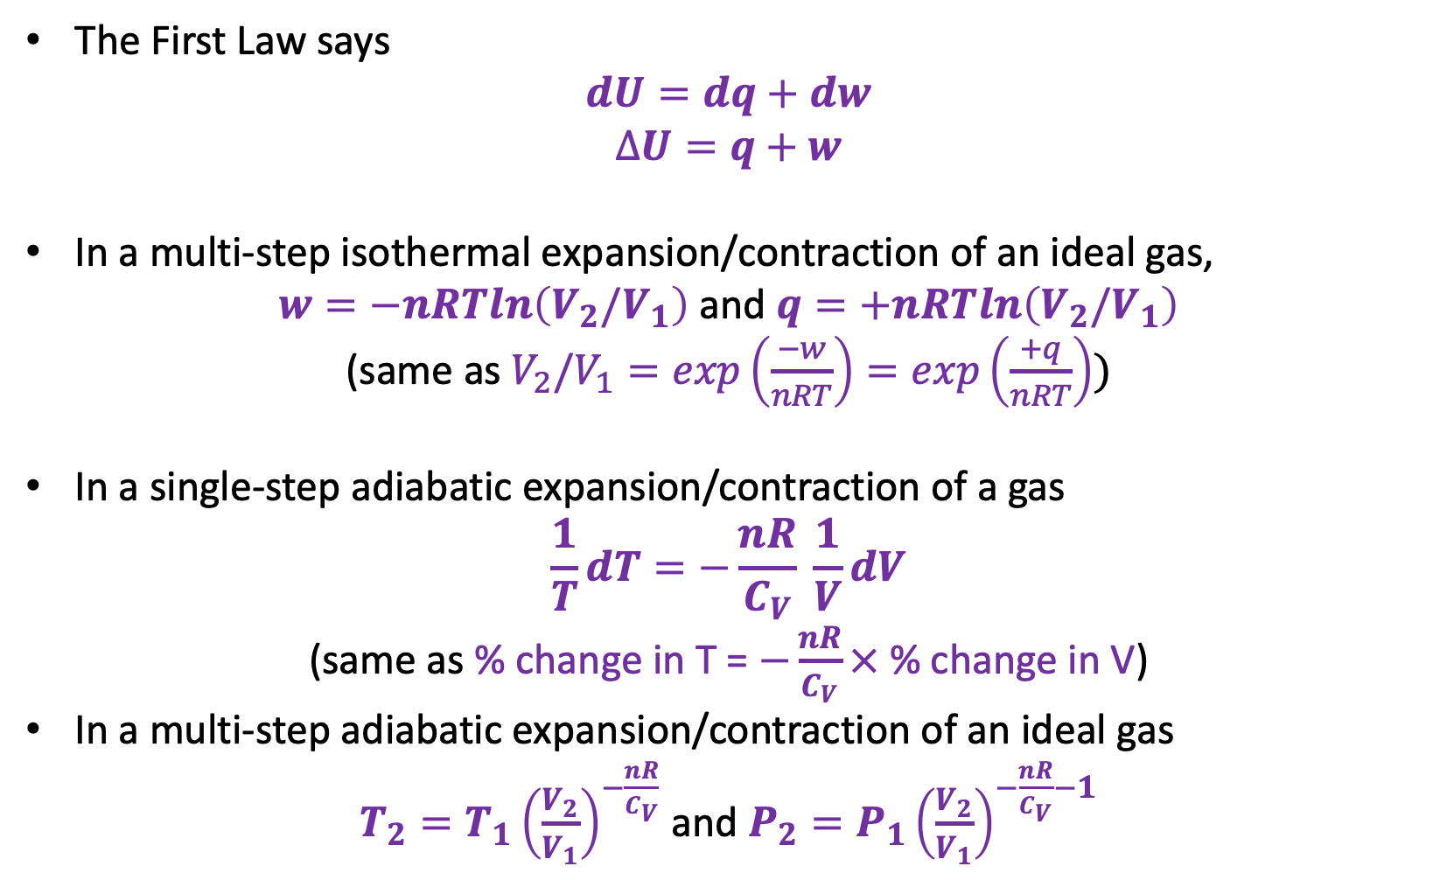
In summary
The First Law says
$$dU=dq+dw$$
$$∆U=q+w$$
In a multi-step isothermal expansion/contraction of an ideal gas,
$w=−nRTln\left(V_{2}/V_{1}\right)$ and $q=+nRTln\left(V_{2}/V_{1}\right)$
(same as $V_{2}/V_{1}=exp\left(\frac{−w}{nRT}\right)=exp\left(\frac{+q}{nRT}\right))$
In a single-step adiabatic expansion/contraction of a gas
$$\frac{1}{T}dT=−\frac{nR}{C_{V}} \frac{1}{V}dV$$
(same as % change in T = $−\frac{nR}{C_{V}}×$ % change in V)
In a multi-step adiabatic expansion/contraction of an ideal gas
$T_{2}={T_{1}\left(\frac{V_{2}}{V_{1}}\right)}^{−\frac{nR}{C_{V}}}$ and $P_{2}={P_{1}\left(\frac{V_{2}}{V_{1}}\right)}^{−\frac{nR}{C_{V}}−1}$

